Slide 1
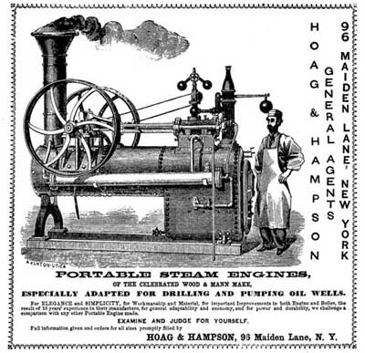
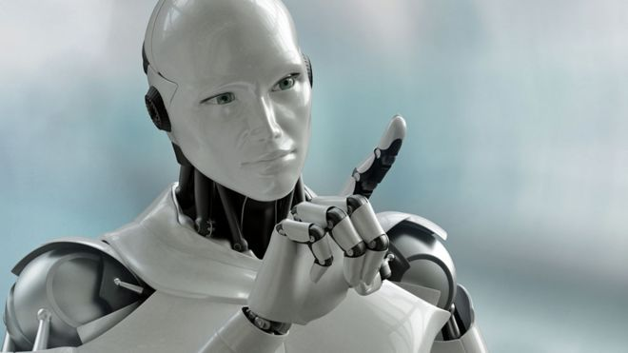
Are you excited or afraid of the ‘march of the machines’?
Gwinear School presents their research and debate on the development and future of machines.
Machines – Friend or Foe?
Exhibition
Hayle Heritage Centre
Private view Tuesday 27th November 2 – 4pm
Exhibition from Wednesday 28th November – Friday 30th November 2018. 11 am – 4pm
Come and see our imaginative work – models, debates, constructions, explanations, all made by pupils in years 5 and 6.

Slide 2
Are you excited or afraid of the ‘march of the machines’?
For
Against
Please vote!

Slide 3
Visitors
Please tell us what you thought

