Slide 1
Open afternoon-20/03/2019 How to support your child in math

Slide 2
Why do people hate maths?
A school has 470 children it wants to take on a trip. The secretary books 7 busses each of which can hold 68 children. Will there be enough seats?
7 x 68 =

Slide 3
At Gwinear we aim to teach mathematics in a way that makes it enjoyable for all children in order to encourage a love of mathematics

Slide 4
Attitude towards mathematics
Studies have shown that a parents math attitude positively influences their child’s math attitude and math achievement

Slide 5
Ways of encouraging a love of mathematics
Let your child observe you trying to solve math problems, i.e. adding up the shopping, weighing ingredients, timing cooking times
Talk about math in a positive way
Encourage your child to help you with simple mathematical tasks, i.e. paying at the shops or sharing objects for siblings or friends
Working with or completing mathematical problems around your child will encourage them to feel more inquisitive about mathematics and will give math a purpose.

Slide 6
Ways to support your child with math
Practice times tables and number bonds
Encourage them to use Mathletics
Play simple counting games in the car or when out and about
If a child becomes frustrated with a problem, use the calculation policy to help them

Slide 7
Our approach to mathematics
Teaching children mathematics is a journey. Children must start by understanding and physically manipulating numbers, to using pictorial representations before moving onto an abstract question.
Start by counting cubes
Move onto pictures of objects
Ending with written numbers

Slide 8
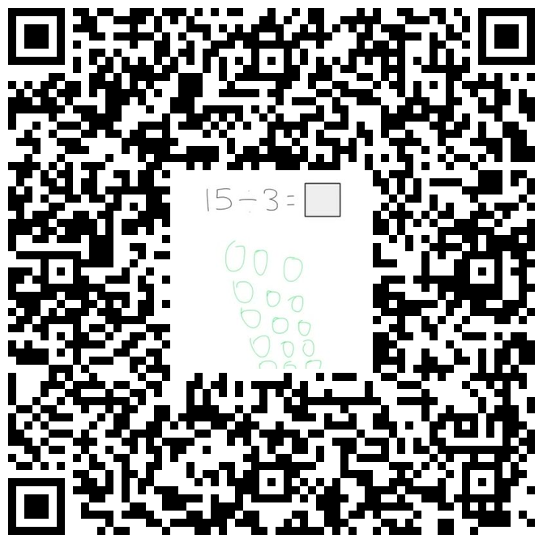
Calculation policy
Our new calculation policy breaks down all of the primary school national curriculum objectives into these three areas. This is available on our school website.
https://www.gwinear.cornwall.sch.uk/website
If you would like example questions or the objectives your children is studying, scroll down to the appropriate operation and year group.
Each new method also comes with a QR code. If you can this code (using any QR code scanner) a video of a child from our school will demonstrate how to solve an example problem.
https://app.seesaw.me/#/class/class.3d333b2f-fc45-4d16-9ca4-721e4c35e998

Slide 9
Our approach to mathematics
At Gwinear we teach mathematics using a variety of different approaches. We work along side the math hub and use the White Rose mastery materials to take children through small steps of learning. These methods encourage children to gain a deep understanding.
Fluency
Understanding number is very important. We focus on children having a high knowledge of number bonds, times tables and number facts to ensure a good foundation for learning
Reasoning
Children move onto explaining their understanding. This encourages a deeper understanding of a method rather than just memorising a written formula
Problem Solving
All children will then progress onto using their fluency knowledge to solve complex problems. By this stage children should have developed a deep understanding of number.

Slide 10
Fluency-Reasoning-Problem Solving
Fluency Reasoning Problem Solving
Count in multiples of 5
5x4=
True or False?
When counting in 5’s, you will only say numbers that end in a 5
Ted has 35 apples, he wants to share them with his 4 friends. How many will each child get?
5, 10, 15, 20, 25, 30…
5x4=20
False because every other number you say ends in a 0, for example
15, 20, 25
Ted+4 friends=5
35÷5=7

Slide 11
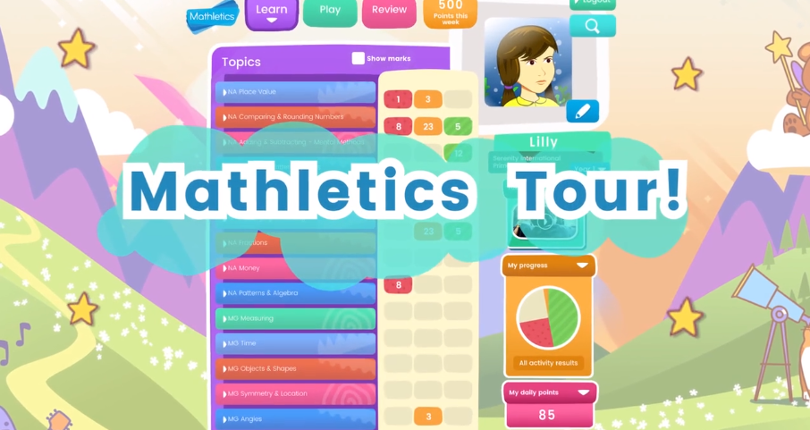
Mathletics
Mathletics is a great tool that school funds for your child to be able to play and learn at home. It is available as an app for apple and android (so can be used on mobiles and tablets) as well as online on a computer or laptop. Although the majority of our pupils are using Mathletics there are some pupils who have never accessed it at home.

